Slide 1
Catalogue
cbsmacu@gmail.com

Slide 2
FOOD

Slide 3
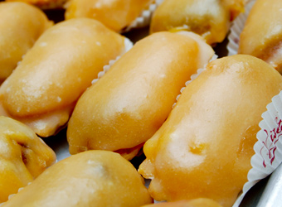
Carbayones
This is a typical sweet from Asturias (Oviedo). It is made with hazelnuts, sugar, eggs, lemon, cinnamon and wine or cognac.
Price: 1€ each
Ref.: 01
cbsmacu@gmail.com

Slide 4
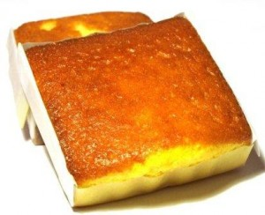
Sobaos
This is a typical sweet from Spain (Cantabria) made with butter, eggs, sugar, honey and flour.
Price: 1€ each
Ref.: 02
cbsmacu@gmail.com

Slide 5
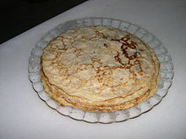
FRISUELOS
It is made up of eggs, milk, salt and flour.
This typical food is very
similar too French’s creeps
but they are healthist and
easier to prepare.
Price: 10 units-5€
This cant be eaten by celiac people
Ref.: 03
cbsmacu@gmail.com

Slide 6
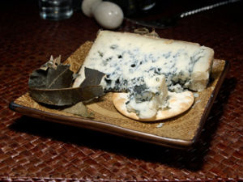
CABRALES CHEESE
It is a kind blue cheese is made from cow's milk , goat or sheep.
It will be has a bluish-green
color and the dough is
creamy , with a very strong smell.
Price: 1kg – 30€
Ref.: 04
cbsmacu@gmail.com

Slide 7
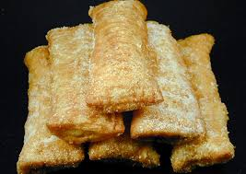
CASADIELLES
Casadielles are a typical dessert of Asturias. Made of nuts, flour, anis and sugar.
Price: 1€ each
Ref: 05
cbsmacu@gmail.com

Slide 8
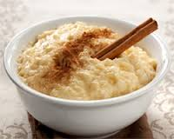
ARROZ CON LECHE
Arroz con leche is a typical dessert of Aturias. Made of rice, milk and sugar.
Price: 1€ each
Ref: 06
cbsmacu@gmail.com

Slide 9
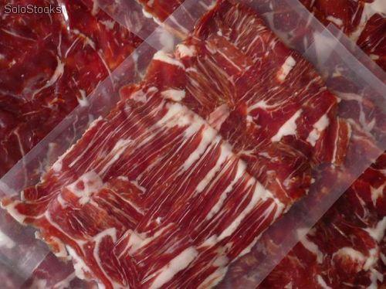
Jamón Serrano
Jamón serrano, is a typical Spanish product, made from salting and air-dried the back legs of the pig. 100g.
Price: 5’95€
Ref: 07
cbsmacu@gmail.com

Slide 10
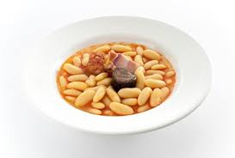
Fabada
Fabada is the traditional Asturian plate made with Asturian beans, chorizo, morcilla and pork. 430g.
Price: 1’85€
Ref: 08
cbsmacu@gmail.com

Slide 11
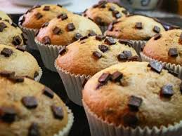
Muffins
A muffin (commonly known in Spanish as Magdalena) is a product made with fresh bread and other ingredients (especially sweets)
They are made up of: 3 eggs, 200 gr. Loose pastry flour, 125 gr. white sugar, 50 ml . whole milk, 100 ml . olive oil extra soft virgin, ½ of chemical yeast ( 8 grams ), silicone molds for cupcakes, crepe paper molds for cupcakes
Price: 0’50€ each
Ref: 09
cbsmacu@gmail.com

Slide 12
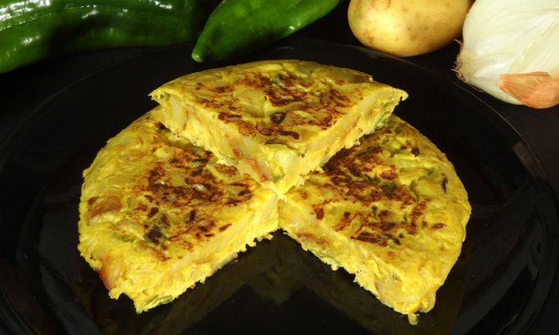
Spanish omelette
The omelette or Spanish omelette is an omelette which means that is beaten egg and then fried potatoes, (although you can add more ingredients like onions or sausage).
They are made up of:(depending of the people) potatoes, onions, green pepper, eggs, extra virgin olive oil and salt. 600g.
Price: 1’60€
Ref: 10
cbsmacu@gmail.com

Slide 13
ACCESORIES

Slide 14
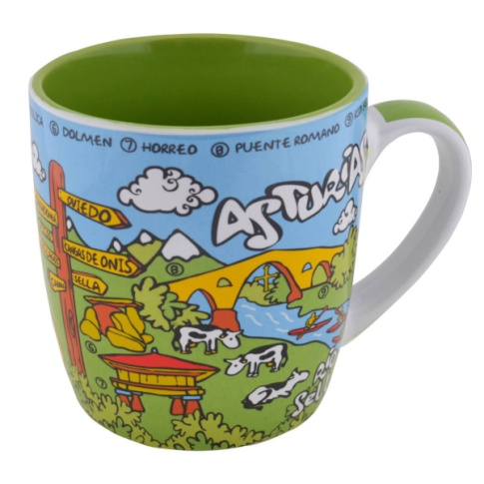
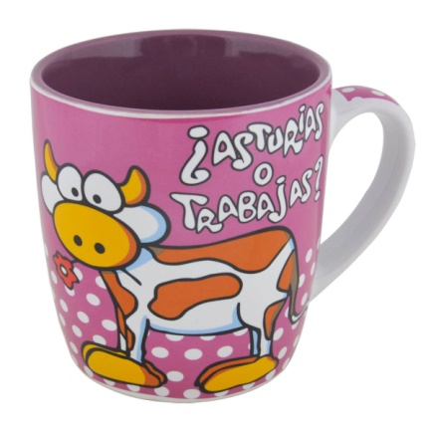
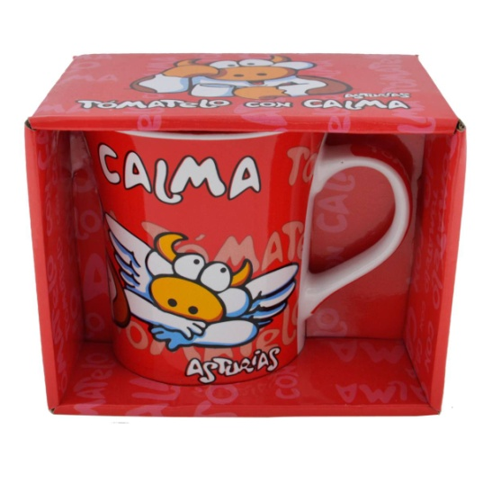
Cup
These are charming cups with different drawings on the sides. Created to have a good cup of coffee or tea with them.
Three models.
Price: 5,50€ (A) 5,50€ (B) 4,95€ (C)
Reference: 11 (A), 12 (B) and 13 (C)
(A)
(B)
(C)
cbsmacu@gmail.com

Slide 15
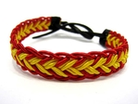
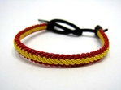
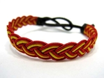
Spanish bracelet
These are really nice bracelets hand-made that are really fancy and cool.
Easy to put and goes with everything. Different models.
Price: 2,50€
Reference: 14(A), 15(B) and 16(C)
(A)
(B)
(C)
cbsmacu@gmail.com

Slide 16
Keyring
These funny cows can keep our keys save. This images are known all over the world and it could be easy to sell them.
Price: 2,50
Ref.: 17
cbsmacu@gmail.com

Slide 17
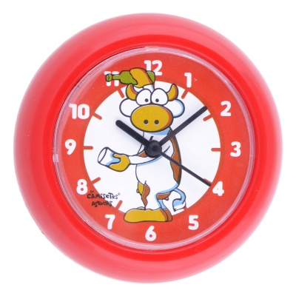
Clocks
These small clocks from 8 cm of diameter are perfect for decorate and useful as well. They are also funny and they remind Asturias because of the draw of the cow with the sidra.
Price: 2,95€ each
Ref.: 18
cbsmacu@gmail.com

Slide 18
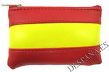
WALLET
Wallet with square form and decorated with the spanish flag.
10 x 6,5 cm
Price: 4€
REF: 19
cbsmacu@gmail.com

Slide 19
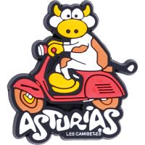
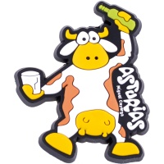
Asturian Magnets
This magnets show the typical asturian cow that appears as corporate image of many shops and places in our region because it is very common as we are a very important region in milk and meet production
Price: 2,50€
Ref.: 20
cbsmacu@gmail.com

Slide 20
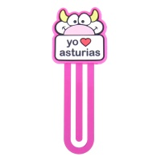
Asturian bookmarks
The bookmarks are used to place in the last page you have written on a book.
Price: 2,50€
Ref.: 21
cbsmacu@gmail.com

Slide 21
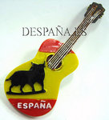
Magnet
Magnet for the fridge with the form of a spanish guitar, our typical instrument.
It has the colours of our flag and also our representative animal the bull.
REF: 22
Price: 2,50 €
cbsmacu@gmail.com
cbsmacu@gmail.com

Slide 22
CLOTHES

Slide 23
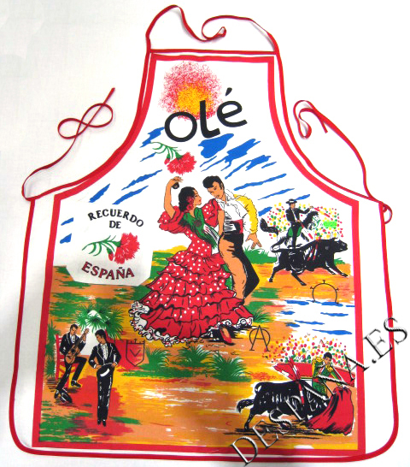
Apron
This apron has pictures of the bulls and flamenco. It also has a pocket.
Unique size.
5€
Ref.: 23
cbsmacu@gmail.com

Slide 24
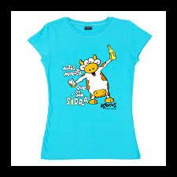
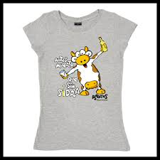
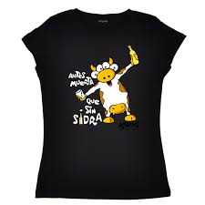
Les Camisetes’ t-shirt
T-shirt with the image of a cow and a phrase.
Colours: Blue, black and grey.
Sizes: XXS, XS, S, M, L, XL
11’95€
Ref.: 24 (blue), 25 (grey), 26 (black)
cbsmacu@gmail.com
cbsmacu@gmail.com

Slide 25
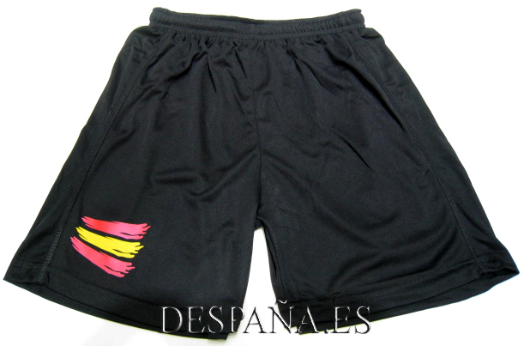
Shorts
Sport’s shorts with the Spahish flat.
Breathable and quick drying.
Elastic and drawstring waist.
Size: M, L, XL
Price: 9€
Ref.: 27
cbsmacu@gmail.com

Slide 26
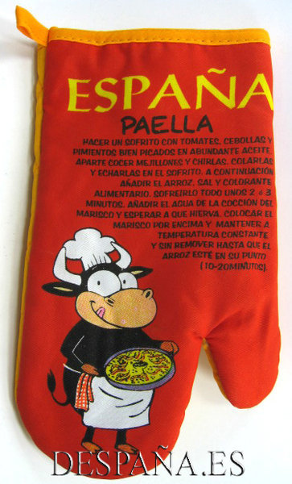
Cooking glove
Spanish glove. It’s useful while taking hot food out of the oven. It’s suitable for all kinds of hands and it shows the recipe of some typical spanish snacks or food (spanish-omelette and “Paella”)
Size: for all types of hands
Price: 4€
Ref.: 28
cbsmacu@gmail.com

Slide 27
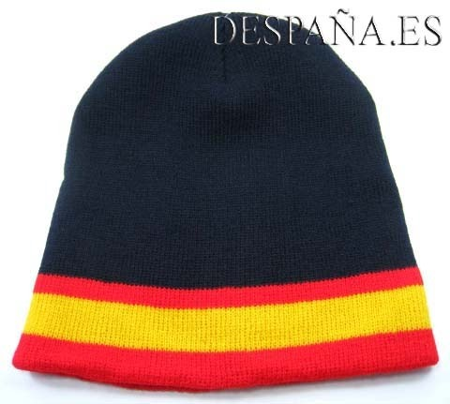
Spanish cap
Spanish cap. It’s black and it has the spanish flag colours at the bottom.
Size: there’s no size. It matches with all types of heads.
Price: 3€
Ref.: 29
cbsmacu@gmail.com

Slide 28
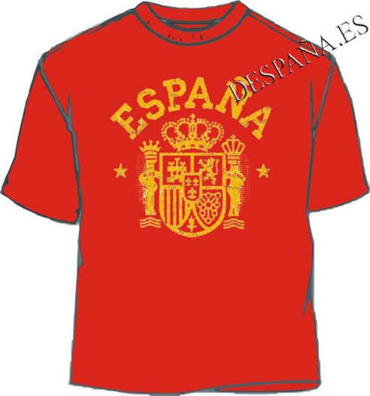
Spanish T-Shirt
Red T-Shirt with the national Spanish coat of arms and the name of “España” on top. It’s made of cotton.
Size: M and S
Price: 8€
Ref.: 30
cbsmacu@gmail.com

