Slide 1
DOME’S CATALOGUE
gogodomegijon@gmail.com

Slide 2
INDEX
FOOD (3-12)
CLOTHES (13-20)
ACCESORIES (21-26)
gogodomegijon@gmail.com

Slide 3
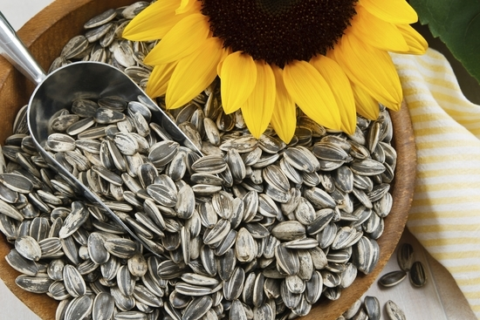
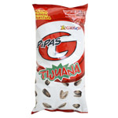
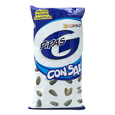
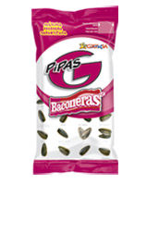
“PIPAS”- SUNFLOWER SEEDS
These seeds are the fruit of the sunflower. You have to remove the peel to consume it.
Packs of 150 gr.
Types: with salt, bacon flavour and tijuana (like barbecue)
Price: 0’45€
REF: 01(S), 02(B), 03(T)
gogodomegijon@gmail.com

Slide 4
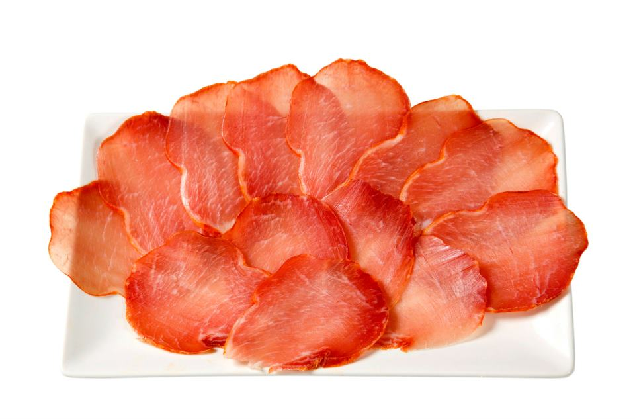
“LOMO” (PORK LOIN)
It’s a type of cold meat from the pig finely cut. You can eat it as a start for the lunch and in a sandwich too.
Pack of 50 gr.
Price: 1€
REF: 04
gogodomegijon@gmail.com

Slide 5
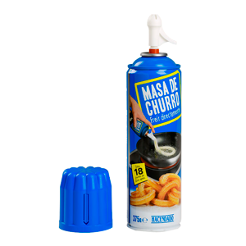
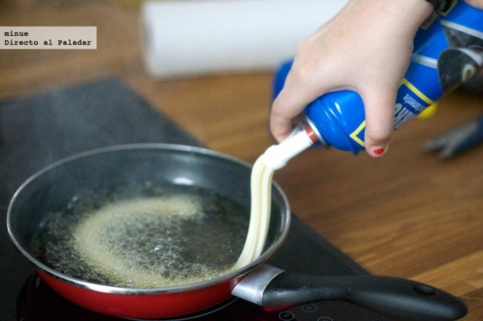
“CHURROS”
They are a mixture of wheat flour that is fried in oil. This product provides de mixtures done.
Bottle of 375 gr.
Price: 2,05€
REF: 05
gogodomegijon@gmail.com

Slide 6
SPANISH OMELETTE (TORTILLA)
It is a typical Spanish food, made with egg, potatoes and fried in vegetable oil (sometimes with onion too).
Types: with onion, without onion.
Pack of 500 gr.
Price: 2,50€
Ref: 06 (O), 07
gogodomegijon@gmail.com

Slide 7
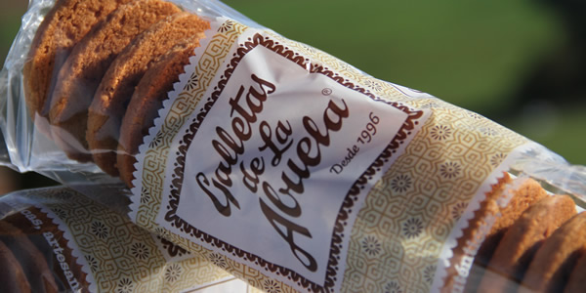
GALLETAS DE LA ABUELA
They are artisan biscuits made of flour, milk, sugar, butter and yeast.
Pack of 340 gr.
Price: 2,50€
REF: 08
gogodomegijon@gmail.com

Slide 8
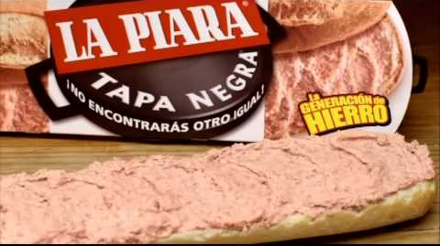
PATÉ
It is a paste make with minced meat or liver and blubber.
3 units of 92 gr.
Price: 3€
REF: 09
gogodomegijon@gmail.com

Slide 9
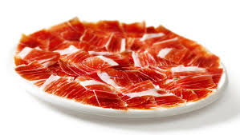
IBERIAN HAM (JAMÓN IBÉRICO)
It is a type of cured ham typical from Spain and it is made from black Iberian pig.
Pack of 120 g
Price: 2,39 €
REF: 10
gogodomegijon@gmail.com

Slide 10
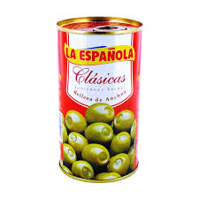
OLIVES
They are the fruit of the olive-tree, they are the most well-known olives of Spain. They are with anchovy.
Bottle of 100 g
Price: 1,23 €
REF: 11
gogodomegijon@gmail.com

Slide 11
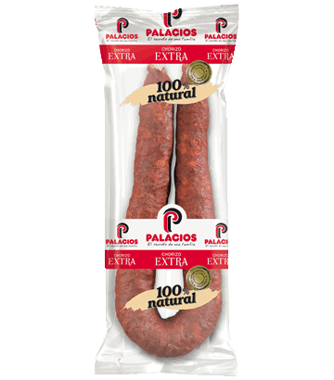
CHORIZO
Chorizo is a term originating in the Iberian Peninsula encompassing several types of pork sausages.
Chorizo can be eaten sliced in a sandwich, grilled, fried, or simmered in liquid, including apple cider or other strong alcoholic beverage such as aguardiente.
250 g
PRICE: 2,85 €
REF: 12
gogodomegijon@gmail.com

Slide 12
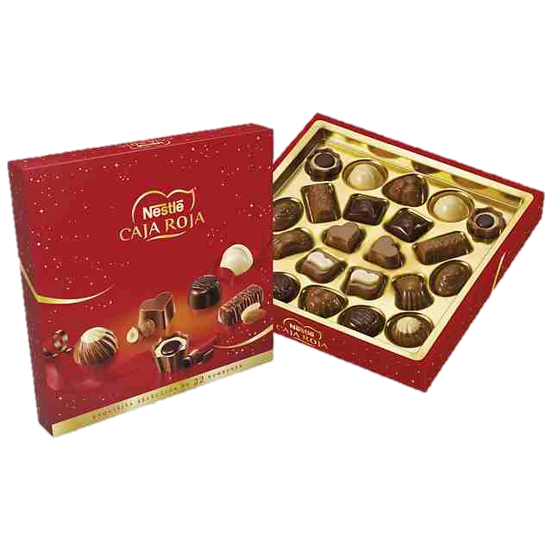
CHOCOLATES
In Spanish ‘bombones’. Chocolate is a typically sweet, usually brown, food preparation of cacao seeds, roasted and ground, often flavored, as with vanilla. It is made in the form of a liquid, paste or in a block or used as a flavoring ingredient in other sweet foods.
They are perfect for presents, or for special occasions or parties.
In this box there is a big variety of flavours for all likes.
Box of 200g.
PRICE: 4’95
REF: 13
gogodomegijon@gmail.com

Slide 13
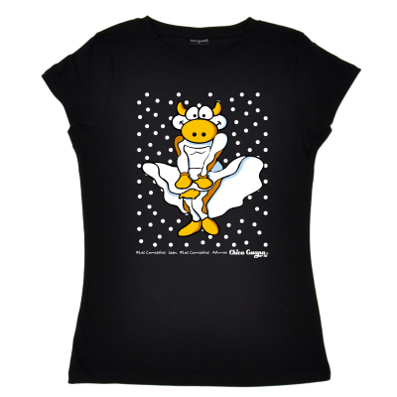
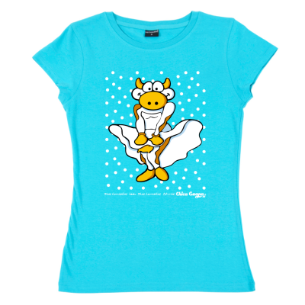
LES CAMISETES
Polyester t-shirt
For women
Colours: Blue and Black
Price: 11,95€
Sizes: XS S M L XL
REF: 14(B), 15(BL)
gogodomegijon@gmail.com

Slide 14
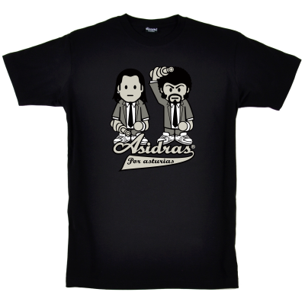
LES CAMISETES
Polyester t-shirt
For men
Only Available in black
Price:11,95€
Sizes: XS S M L XL
REF: 16
gogodomegijon@gmail.com

Slide 15
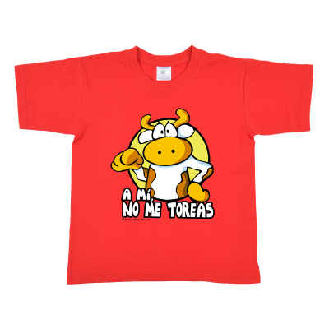
“A mi no me toreas” T-SHIRT
Colour: Red
Price-9’95 euros
Sizes- from 32 wide to 46 cm & from 44 high to 60 cm.
REF: 17
gogodomegijon@gmail.com

Slide 16
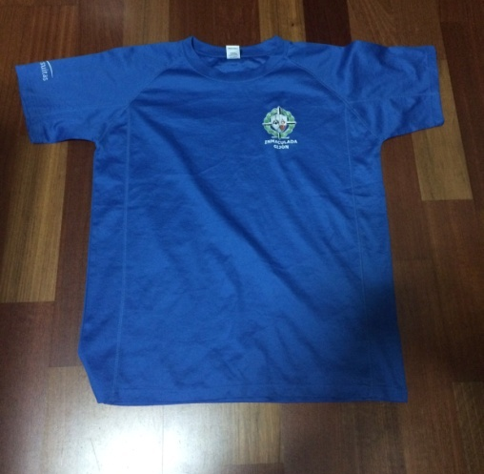
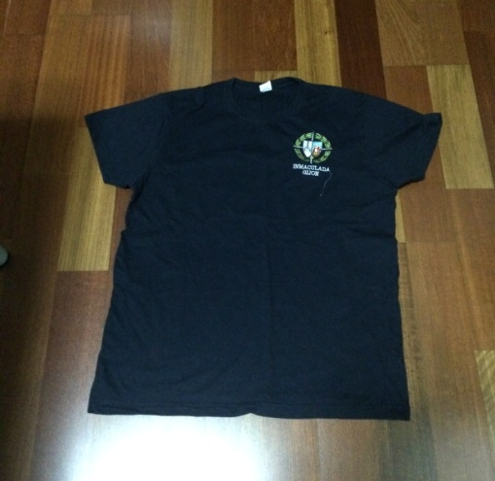
SCHOOL’S SPORT T-SHIRT
Colegio Inmaculada’s special t-shirts for practicing sport.
Colours: White, Blue and Dark Blue.
Size: XS, S, ML, XL, XXL.
Price: 15€
REF: 18(W), 19(B), 20(DB)
gogodomegijon@gmail.com

Slide 17
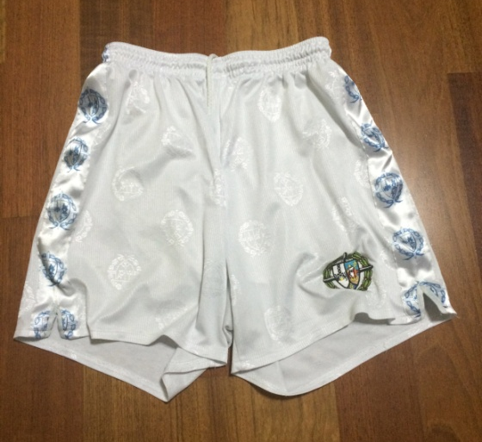
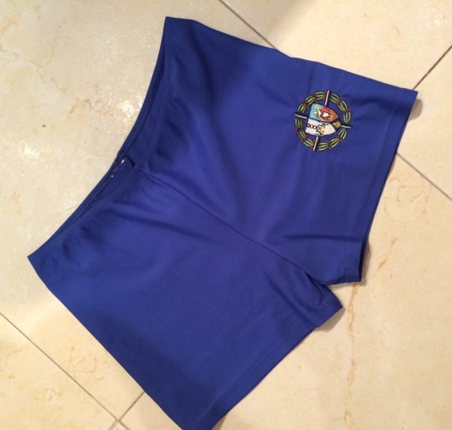
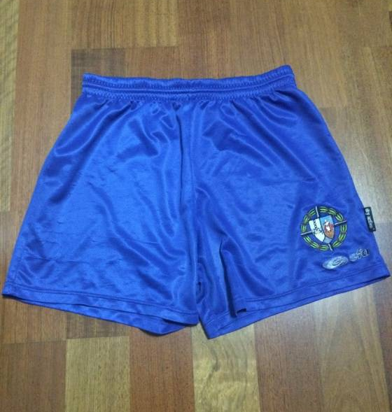
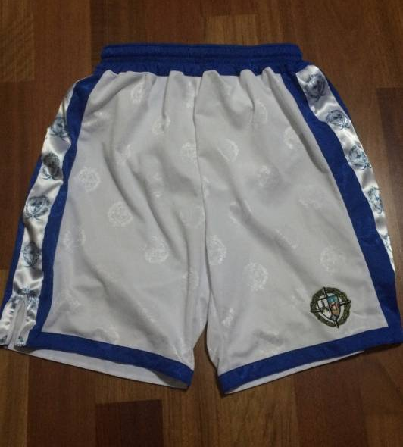
SCHOOL’S PANTS
Sweatpants designed for practicing sport. (the sweatpants that are in the upper right part are for volleyball and the ones below is for basketball mainly).
Measures depends on size.
Price: 15€
REF: 21(W) 22 (B) 23 (VB) 24 (BW)
gogodomegijon@gmail.com

Slide 18
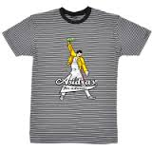
LES CAMISETES
This is a shirt with black and white stripes with a picture in the middle.
Sizes: XS S M L XL
Price: 11’95€
REF: 25
gogodomegijon@gmail.com

Slide 19
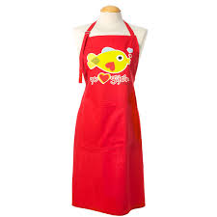
LES CAMISETES, APRON
This is a red apron that includes a drawing of a fish.
Price: 7’95€
REF: 26
gogodomegijon@gmail.com

Slide 20
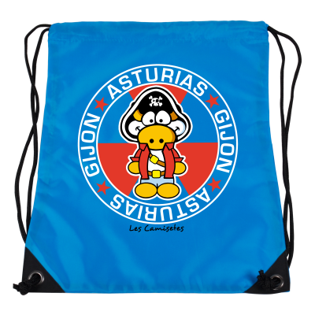
LES CAMISETES, BAG
It’s a bag with a pirate cow and with the name Asturias/Gijón.
Colour: Blue
Price- 6’50 euros
Wide- 34 cm
High- 45cm
REF: 27
gogodomegijon@gmail.com

Slide 21
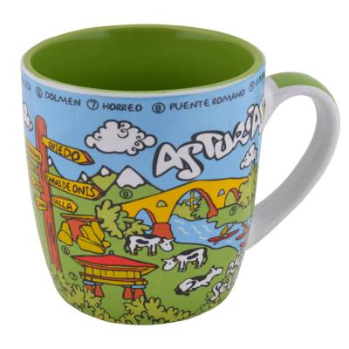
LES CAMISETES, CUP
It´s a cup that have images of different things that are typical in Asturias. It has explanations of the monuments and living beings that appear in this object.
Price: 5,50€
REF: 28
gogodomegijon@gmail.com

Slide 22
LES CAMISETES, MAGNET
This is a magnet for the fridge whose image consist of the cow, a popular bridge in Asturias and the most typical drink: the cider.
Price: 2,50€
REF: 29
gogodomegijon@gmail.com

Slide 23
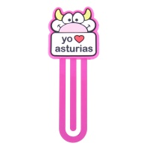
BOOKMARK
Small bookmark saying “I love Asturias”
Price: 2,5 €
REF: 30
gogodomegijon@gmail.com

Slide 24
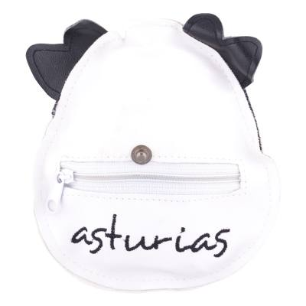
BAG
It is a white and black bag with theshape of a typical asturian cow.
Price:3,50 €
Wide:40cm.
High:43cm.
REF: 31
gogodomegijon@gmail.com

Slide 25
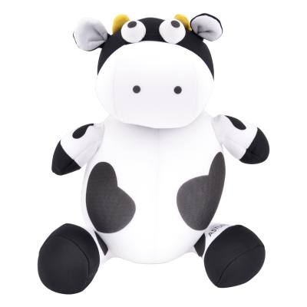
TOY
It’s a toy with the shape of a cow made by foam.
Price:6,95 €
High:26cm
REF: 32
gogodomegijon@gmail.com

Slide 26
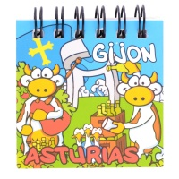
SMALL NOTEBOOK
Small notebook with 80 pages and a magnet to put in the fridge.
Price: 1,95 €
REF: 33
gogodomegijon@gmail.com

