Slide 1
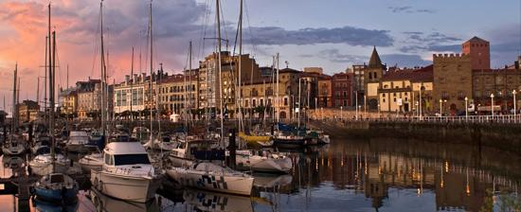
Catálogo de productos
Catalogue

Slide 2
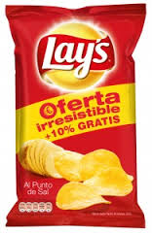
Chips Lay’s
“Campesinas” Lay’s chips
Lay’s chips
They are natural
salad chips.
170g - 2,21€
It is made with olive oil and garlic, it follows the “campesina” recipe.
#001
#002
170g - 2,21€

Slide 3
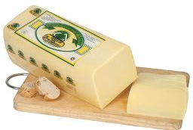
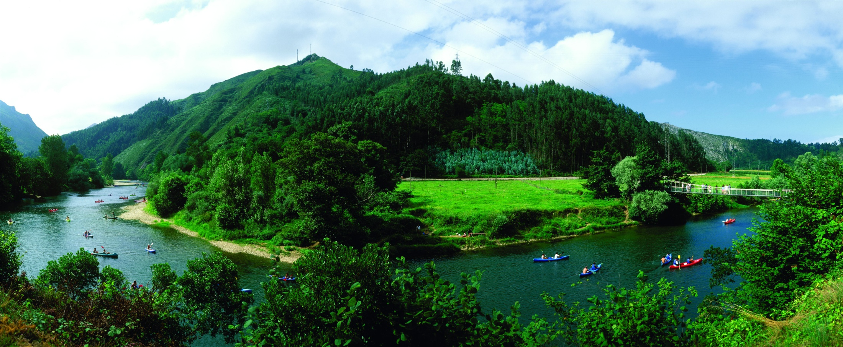
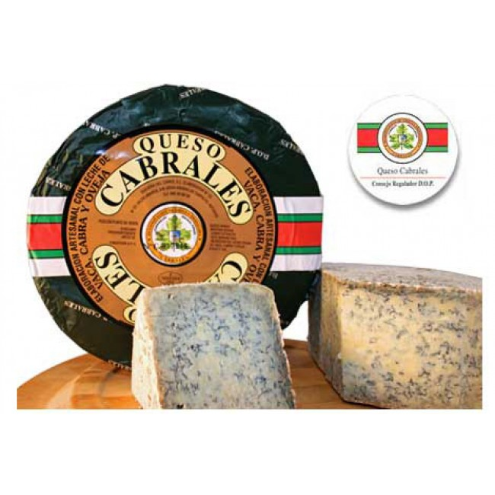
“Tres oscos” cheese
Cheeses
#003
It is a cured cheese made from cow's milk.
All of these cheeses are typical from Asturias.
7.95 € – 750g
“Cabrales”cheese
#004
It is made with three milks (cow, goat and sheep). It presents soft, yellow-reddish bark and it’s white with blue-green pigmentation.l
9.50 €– unit (about 400 g)

Slide 4
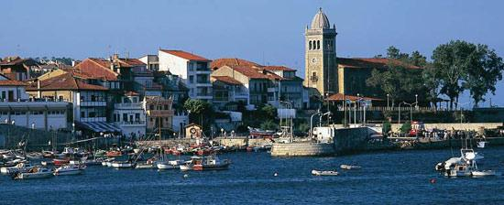
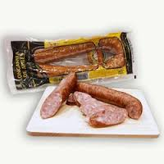
Sausages
White pork sausage
It is a traditional white pork sausage, typical from the town of Avilés and ideal for cooked or fried consumption.
#005
2.95€– unit (about 315 g)

Slide 5
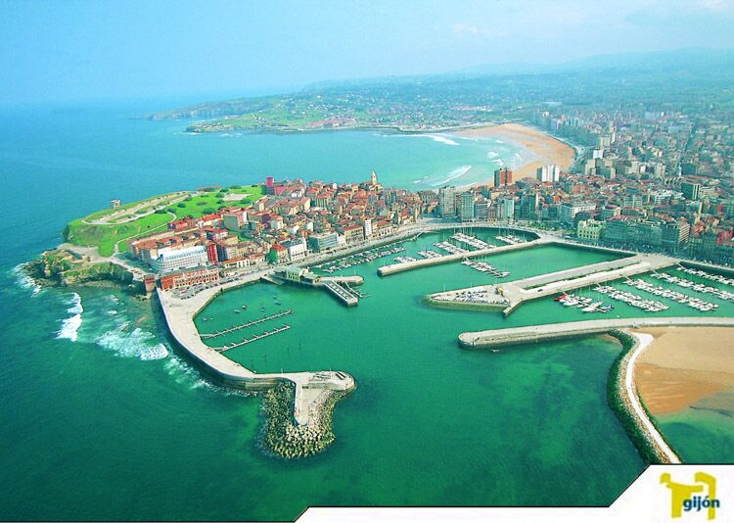
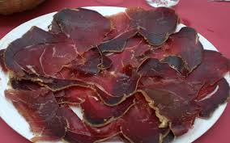
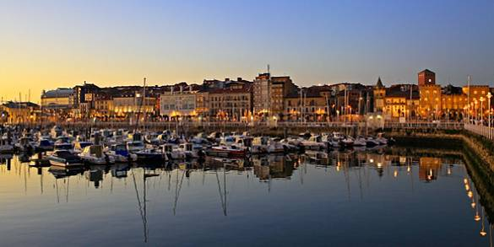
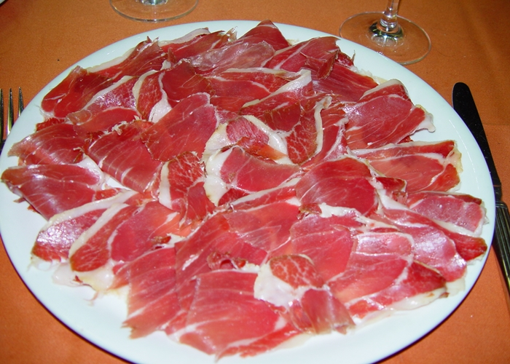
Slices
Slices of cured meat
It is obtained from the pieces of beef cured naturally cold and air and slightly smoky.
#006
5.7 € - 150g
Slices of ham
It has a natural cure for over a year and slightly smoky.
#007
Slices
4.5 € - 150 g

Slide 6
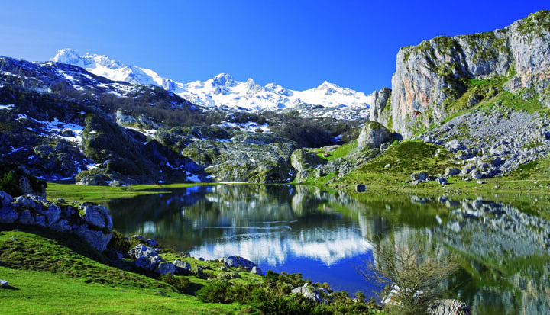
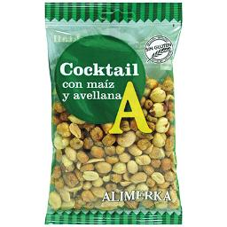
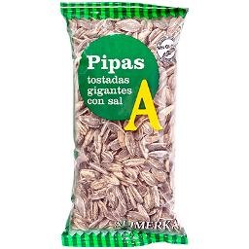
Died fruit and nuts (mix)
#009
Sunflower seeds
#008
Sunflower seeds are edible seeds originating from the plant commonly called Sunflower
They are very energetic foods high in fat, protein and trace elements
Unit (125 g) - 2€
Unit (150 g) - 2€

Slide 7
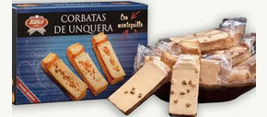
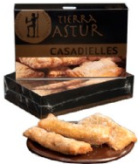
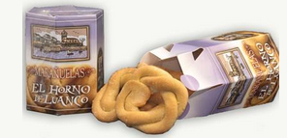
Sweet
“Corbatas de Unquera”
“Casadielles”
“Marañuelas”
It is a sweet pastry made from wheat flour, butter, margarine, sugar, egg, almonds and salt.
#010
3.9 € - 10 units
It is a type of biscuit that is made with flour, sugar, egg yolks, butter and peel lemon.
It is one of the most typical dessert in Asturias. It is make with hazelnut , walnuts , butter , wheat flour and it is fried in olive oil.
#012
#011
6€ - 12 units
4.5€ - 6 units

Slide 8
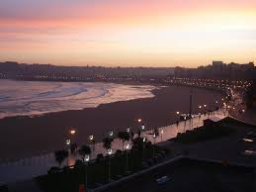
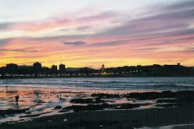
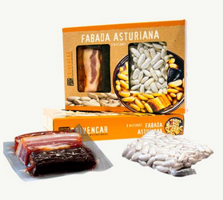
Apple jam
It was made in Peñamellera Alta (Asturian place) with apples and sugar cane.
#013
3.5€ - unit (350g)
Asturian stew
It is the most typical plate in Asturias , it has fabas, bacon, ham, chorizo and black pudding.
#014
7.5 € - 2 portions

Slide 9
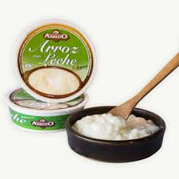
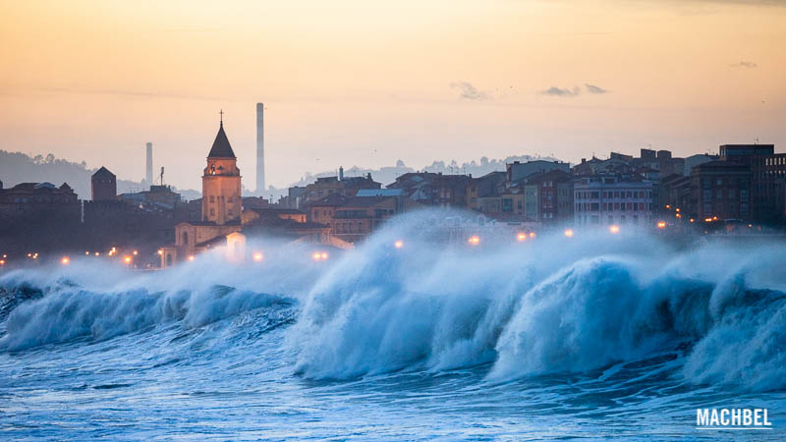
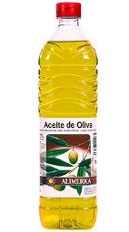
Rice with milk
#016
It is made with cow's milk, sugar, rice, cinnamon, lemon, anise and salt. It follows the typical recipe and it’s the most traditional dessert in Asturias.
Olive oil
Olive oil is obtained from the fruit of the olive tree. You can use it for fry meat, fish… and for dress a salad.
1.2 € - unit (200 g)
#015
Unit - 3,50€

Slide 10
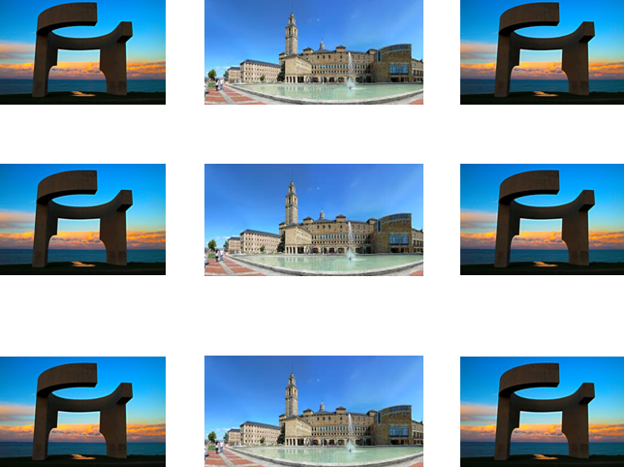
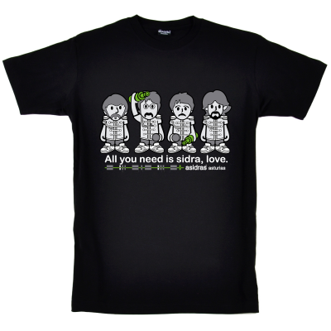
Asturian themed key-rings
Asturian themed t-shirts
#018
#017
1ud-2.95€
#019
Size (S-XXL)
1ud-11.95€

