Slide 1
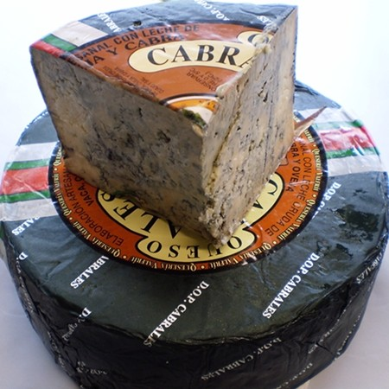
Queso cabrales (550 g)
Cabrales cheese:
It is a very strong blue cheese, which is made with milk of cow, goat and sheep. It´s practically without peel, when it is mature it has a blue green colour and its dough is creamy. It´s elaborated in Natural Caves with a lot of humidity and wet.
10,45 € / 7.36 pounds approx.

Slide 2
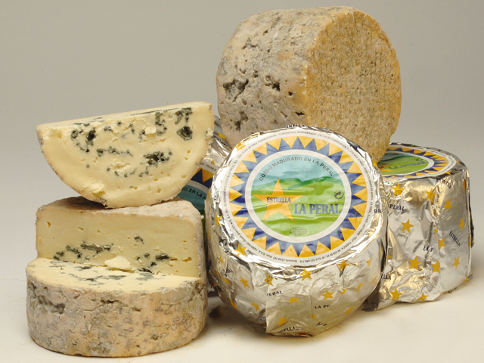
Queso “la peral” semi-azul (750 g)
La Peral Cheese:
It´s made with pure cow milk with a soft flavour.
11,25 € / 7,93 pounds approx.

Slide 3
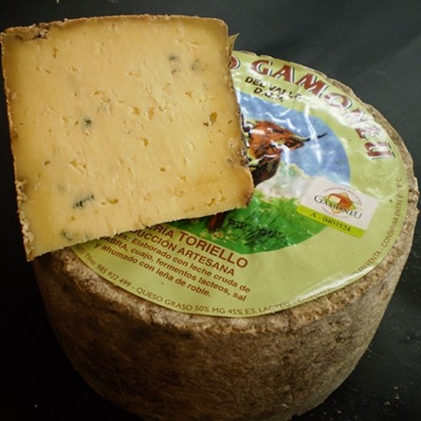
Queso “gamoneu” (600 g)
Gamoneu Cheese:
It is an oily matured cheese, natural bark, elaborated with milk of cow, sheep and goat. The dough is hard or semi hard. Soft flavour and a bit spicy taste.
12,70 € / 8,95 pounds approx.

Slide 4
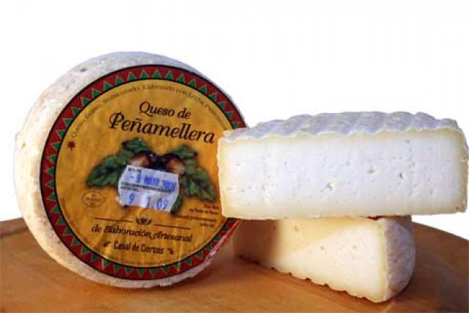
Queso “peñamellera” a la sidra (300 g)
Peñamellera Cheese
Yellow and compact color with a strong and bit acid flavour. It’s made with cow milk.
4,95 € / 3,49 pounds approx.

Slide 5
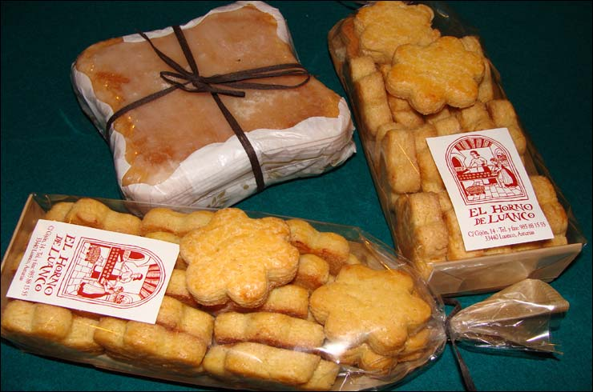
Bollos de marañuela (docena)
Marañuelas (Asturian Scones)
A typical Asturian sweet made of eggs, sugar, butter and bread elaborated in the shape spiral.
6,60€ / 4,65 pounds approx.

Slide 6
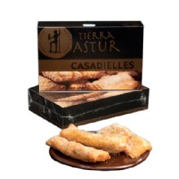
Casadielles (docena)
Casadielles:
It is a typical Asturian sweet, a species (kind) of small pie fried or baked, elaborated with mass of wheat refills with nuts or hazelnuts, sugar and anise, is in the habit of serving as dessert.
8,70 € / 6,13 pounds approx.

Slide 7
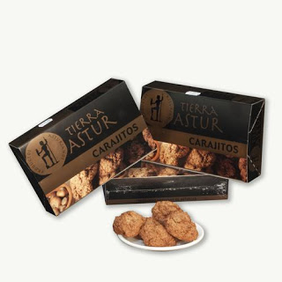
CARAJITOS (350 G)
Carajitos:
Hazelnut or nut biscuits, made of eggs and sugar.
5,75€ / 4.05 pounds approx.

Slide 8
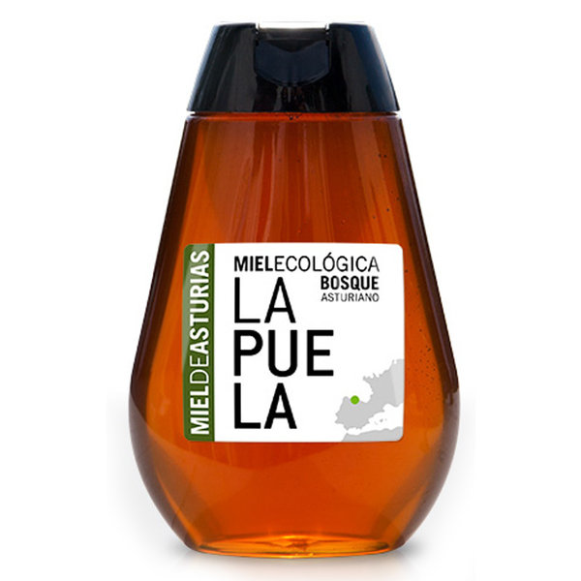
MIEL ECOLOGICA “LA PUELA” (350 G)
Ecological Honey “la Puela”
Ecological honey which comes from the nectar of the chestnut-tree flowers . Its flavour is sweet but with some cent of salty taste.
4,95€ / 3.49 pounds approx.

Slide 9
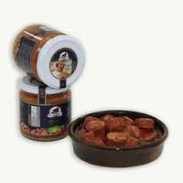
CHORIZOS A LA SIDRA (220 G)
Boiled Spicy Sausages
They are boiled with water and a bit of cider and thickly sliced in small pieces to be eaten.
3,6€ / 2.54 pounds approx.

Slide 10
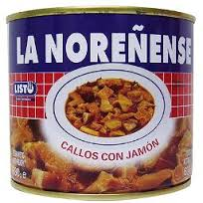
CALLOS CON JAMÓN (630 G)
Tripe with ham.
It is a dish made of the stomach and the guts of the pork, accompanied with ham and with a bit (spicy), slightly strong flavor.
4,15€ / 2.92 pounds approx.

Slide 11
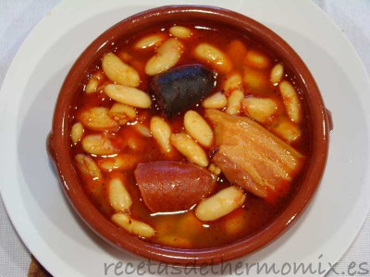
Fabada asturiana (765 g)
Asturian Beans.
It is a traditional stew of the Asturian cuisine made of local Asturian beans, spicy pork sausages, ham, bacon and blood sausage.
3€ / 2.11 pounds approx.

Slide 12
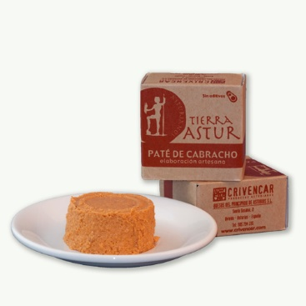
Paté de cabracho (100 g)
Cabracho Pâté
It´s a kind of mash, pure made of semioily and prepared meat from cabraco, scorpion fish. It´s traditionally eaten with some mayonnaise on top.
2,45 € / 1.73 pounds approx.

Slide 13
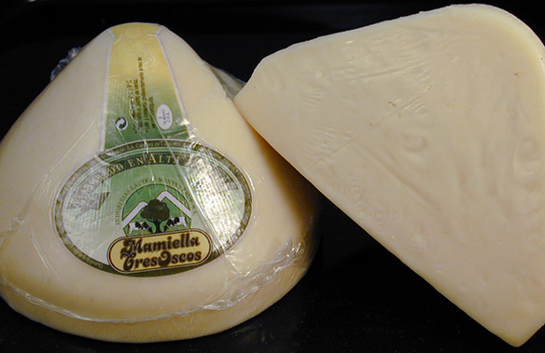
Queso “tres oscos” (750 g)
3 Oscos Cheese
Oily cheese of big size made with cow milk (great for sandwiches)
8,75€ / 6.16 pounds approx.

Slide 14
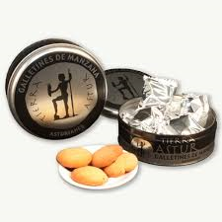
Galletas de manzana (380 g)
Apple biscuits
They are made with a typical Asturian fruit with a sweet and a bitter flavour.
6,55€ / 4.61 pounds approx.

Slide 15
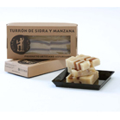
Turrón de sidra y manzana (300 g)
Apple and cider nougat
It´s a typical sweet of Christmas time normally made of almond, sugar, cider and apple.
5,75 € / 4.05 pounds approx.

Slide 16
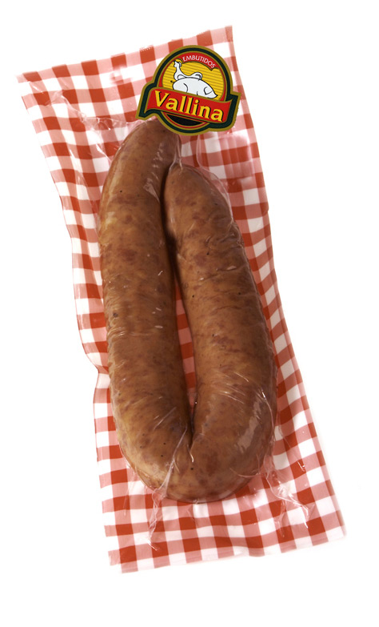
Longaniza casera extra (400 g)
Home-made pork sausage (Llonganissa)
It´s a stuffed sausage filled with mince pork meat.
4,80€ / 3.38 pounds approx.

Slide 17
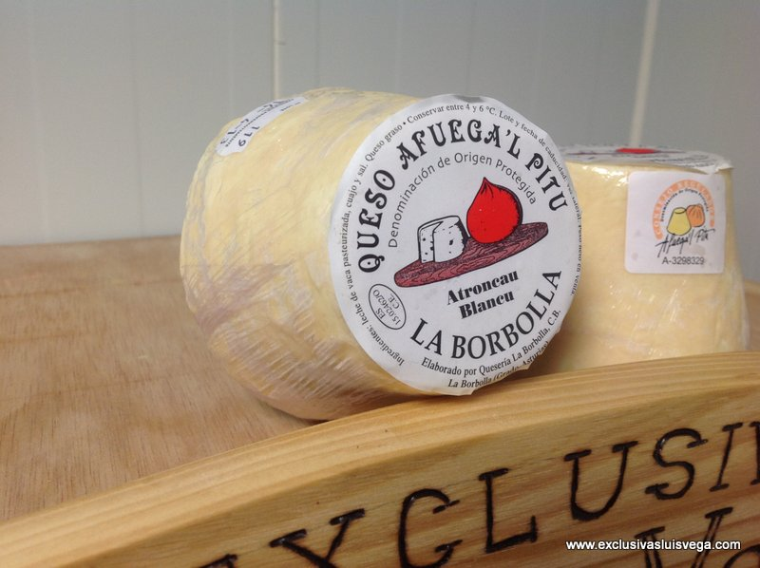
Queso “afuega’l pitu blanco” (300 g)
Afuega’l pitu Cheese:
Oily cheese that can be fresh air or matured, elaborated with pure, milk of cow. It has an acid flavour, a bit salty or no salty at all, creamy and too dry.
4,35 € / 3.06 pounds approx.

Slide 18
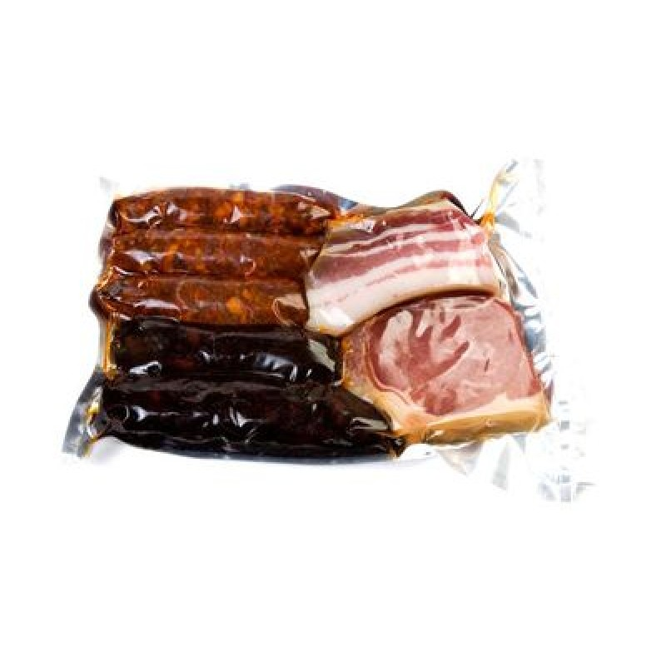
lote de guisos clásicos de Asturias
(780 g)
A collection of Stews
They contain pork sausage, spicy sausage, bacon and ham. It´s raw packed.
11,50 € / 8.10 pounds approx.

Slide 19
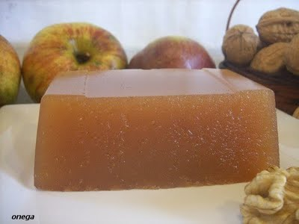
Dulce de manzana (400 g)
Apple sweet
It is got from the apple pulp, together with sugar. It is mainly eaten with cheese as a dessert.
2,50€ / 1.76 pounds approx.

Slide 20
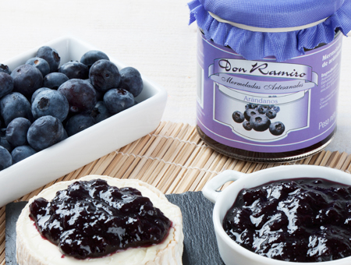
Mermelada de arándanos (250 g)
Cranberry jam
Jam made of Cranberry (typical fruit from the Asturian forests) with an acid flavour.
2,75€ / 1,94 pounds approx.

Slide 21
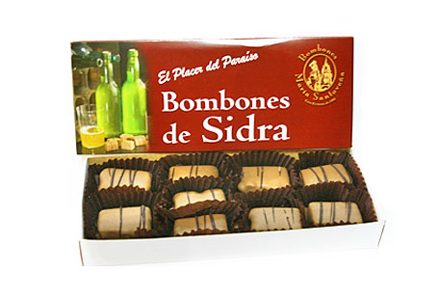
Bombones de aguardiente de sidra (200 g)
Cider Chocolates
Homemade chocolates stuffed with brandy cider chocolates
14,45 € / 10,18 pounds approx.

Slide 22
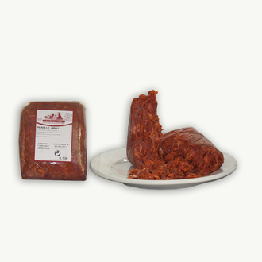
Picadillo de jabalí (500 g)
Boar mince
5,25 € / 3,70 pounds approx.

Slide 23
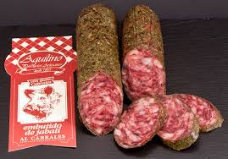
Salchichón de jabalí al cabrales
Boar salami with Cabrales sauce.
Boar meat (the boar is a typical animal in Asturias) accompanied with Cabrales cheese.
6,55€ / 4,60 POUNDS APPROX.

Slide 24
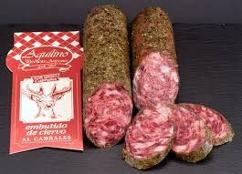
Salchichón de ciervo (350 g)
Spanish deer sausage
6,05€ / 4,26 pounds approx.

Slide 25
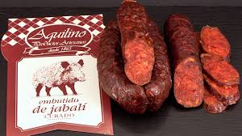
Chorizo de jabalí (300 g)
4,95€ / 3,49 pouns approx.

Slide 26
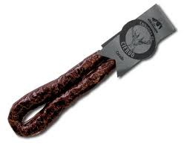
Chorizo de ciervo (300 G)
4,95€ / 3,49 pounds approx

Slide 27
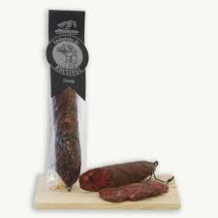
Chorizo de avestruz (300 g)
3,75€ / 2,64 pounds approx.

Slide 28
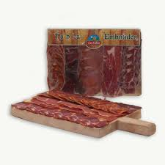
Tabla de embutidos loncheados asturianos (250 g)
A collection of Stews
They contain pork sausage, spicy sausage, bacon and ham. It´s raw packed.
9,35 € / 6,59 pounds approx.

