Slide 1
CATALOGUE
teenshop13@hotmail.com

Slide 2
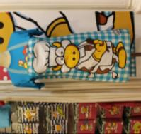
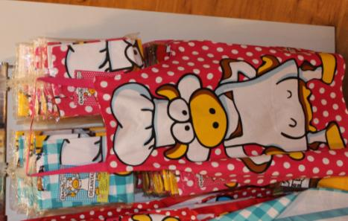
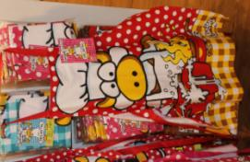
Asturian apron
teenshop13@hotmail.com
- Asturian Apron designed for home chefs. They have one of the symbols of Asturias, a cow, and are available in 3 different colors. There is only one size.
- Price: 6.55 €
- Ref:
Pink - 001
Red - 002
Blue - 003

Slide 3
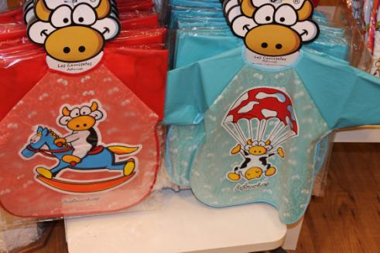
ASTURIAN BIB
teenshop13@hotmail.com
- Two types of bibs with a picture of a cow for small children. Available in two different colors.
- Waterproof and with long arms.
- Price: 4.50 €
- Ref:
Red - 004
Blue - 005

Slide 4
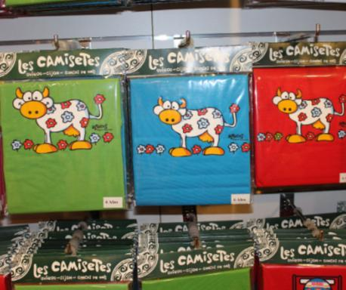
ASTURIAn T-SHIrt
teenshop13@hotmail.com
- Two types of t-shirts for kids with the picture of a cow and the word “Asturias” next to it. Available in three different colors.
- Price: 5.50 €
- Ref:
Red - 006
Green - 007
Blue - 008

Slide 5
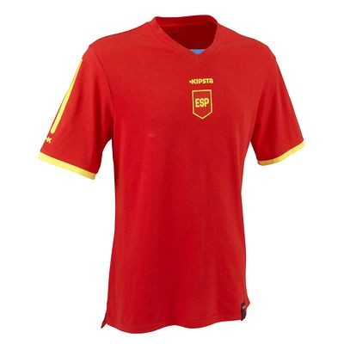
Spanish t-shirt
teenshop13@hotmail.com
- Designed for playing football or any other sport and also for the fans who claim their colors. This t-shirt is made ​​from a polycotton component to prevent moisture transfer and limit odors.
- Price:
11.50 € (adults)
10.50 € (kids)
-Reference:
Adutls – 009
Kids - 010

Slide 6
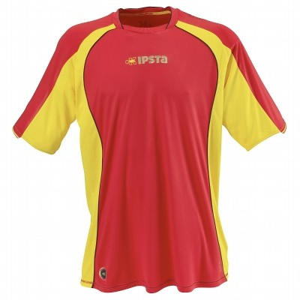
Spanish t-shirt (2)
teenshop13@hotmail.com
- Designed for playing football regularly 2 times a week and also for the fans who claim their colors.
- Price: 11.50 €
-Reference: 011

Slide 7
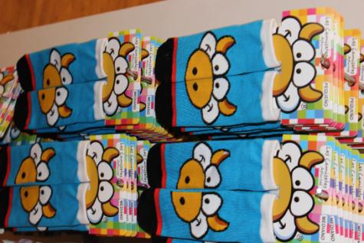
Cow socks
teenshop13@hotmail.com
- A pair of wool socks with
the typical animal from
Asturias, the cow.
- Price: 2.50 €
- Ref: 012

Slide 8
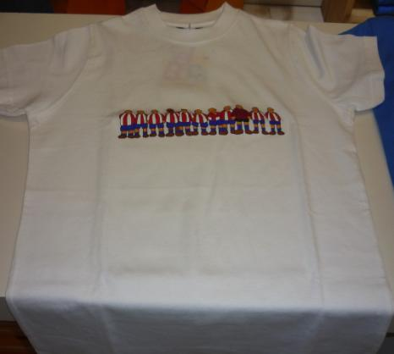
Callate la boca t-shirt(1)
teenshop13@hotmail.com
- A t-shirt from the shop “Callate la boca”, a spanish shop. It has a drawing of the Sporting the football team in Gijón. They have the t-shirt in all colours and sizes. Made of cotton.
- Price:
2-3-4: 20’5 euros
6-7-8: 24’5 euros
Adults: 29’5 euros
- Ref:
2-3-4: 013
6-7-8: 014
Adults: 015

Slide 9
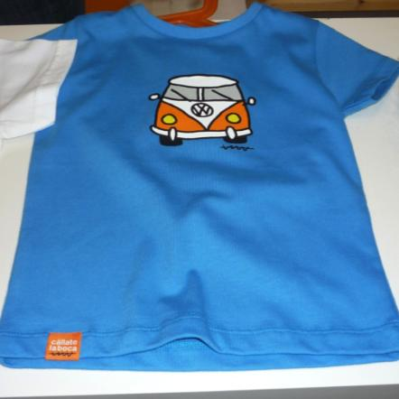
Callate la boca t-shirt(2)
teenshop13@hotmail.com
- A t-shirt from the Spanish shop”Callate la boca”. It has a drawing of a van. They have the t-shirt in all sizes and colours, made of cotton.
- Price:
2-3-4: 20’5 euros
6-7-8: 24’5 euros
Adults: 29’5 euros
- Ref:
2-3-4: 016
6-7-8: 017
Adults: 018

Slide 10
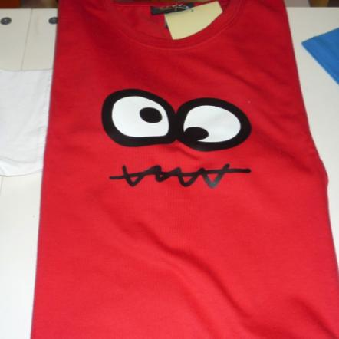
Callate la boca t-shirt(3)
teenshop13@hotmail.com
- A t-shirt from the Spanish shop”Callate la boca”. It has a drawing of the logo of the shop. They have the t-shirt in all sizes and colours, made of cotton.
- Price:
2-3-4: 20’5 euros
6-7-8: 24’5 euros
Adults: 29’5 euros
- Ref:
2-3-4: 019
6-7-8: 020
Adults: 021

Slide 11
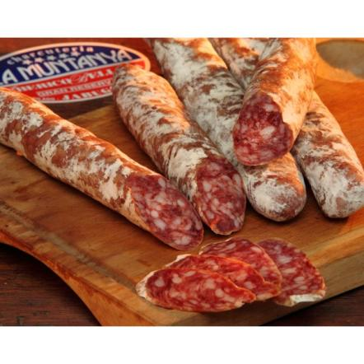
FUET
teenshop13@hotmail.com
- The salami is a type of sausage, popular in Spain. It’s made of minced meat mixed with garlic and pepper. It’s so delicious if you have it with bread, as special sandwich.
- Price: 2.20€ (150g)
- Ref: 022
YOU’LL LIKE IT

Slide 12
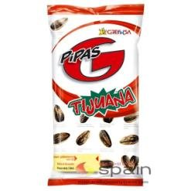
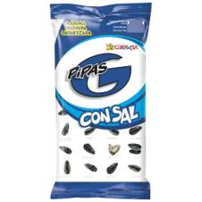
PIPAS(Seeds)
teenshop13@hotmail.com
- Delicious seeds that come from the sunflowers. You can choose your favourite flavour because there are a lot of types in the market. This Spanish product is special because once you start eating them, you cannot stop.
- Price: 0.35 €
- Ref:
Salted flavour: 023
Barbecue flavour: 024
0NLY 0.35€

Slide 13
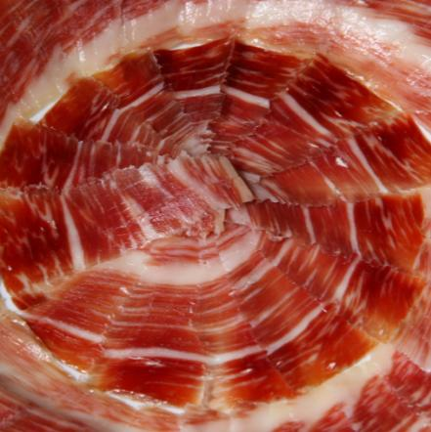
SPANISH HAM
teenshop13@hotmail.com
- Tasty ham typical from Spain with good quality. You can have it with bread to have a nice meal. The best starter you can have for your guests or yourself.
- Price: 3.50 € (200g)
- Ref: 025
I wouldn´t live without having it!!

Slide 14
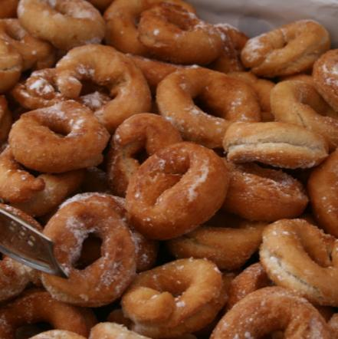
ROSQUILLAS
teenshop13@hotmail.com
- Amazing home-made donuts covered with sugar. Easy to make but these ones are special because they have a secret ingredient.
- Price: 3.20€ (1kg)
- Ref: 026
HOME-MADE PRODUCT!!

Slide 15
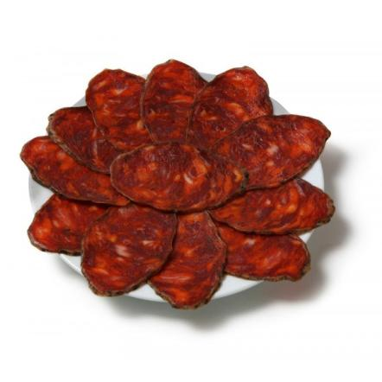
CHORIZO
teenshop13@hotmail.com
- It comes from the pig, it’s similar to red sausages. You usually cut it in pieces before having it. In Spain, people usually have a sandwich mixed with chorizo at 6 p.m. like a small snack.
- Price: 2.75 € (1kg)
- Ref: 027
HAVE NO DOUBT AND TAKE IT!!!!!

Slide 16
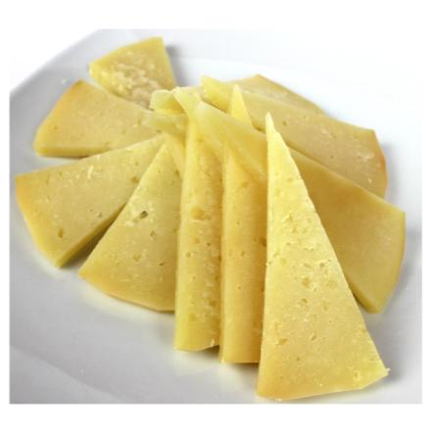
MANCHEGO CHEESE
teenshop13@hotmail.com
- It comes from sheep’s milk and it takes a lot of time to produce this wonderful product. It’s natural because it’s kept in caves to take the special flavour that it needs to be perfect.
- Price: 4.95 € (250g)
- Ref: 028
NATURAL PRODUCT

Slide 17
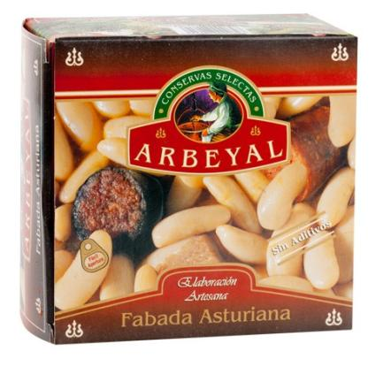
Fabada Asturiana
teenshop13@hotmail.com
- Delicious traditional asturian beans, try them! Ingredients:
Special beans 40%
Cooking water,
Bacon 12%
Chorizo ​​12%
Sausage 12%
Salt and Saffron.
-Price: 3.46 €
-Reference: 029

Slide 18
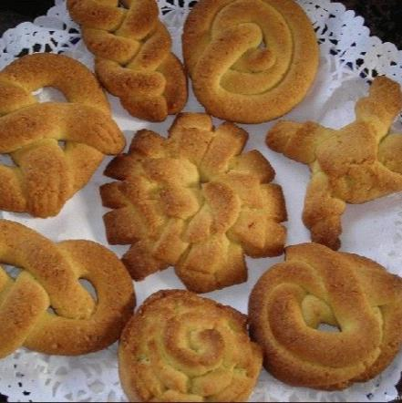
marañuelas
teenshop13@hotmail.com
- 12 delicious marañuelas, ready for being eaten. Ingredients:
Flour
Sugar
Yolks
Butter
Lemon
- Price: 6.60 €
- Reference: 030

Slide 19
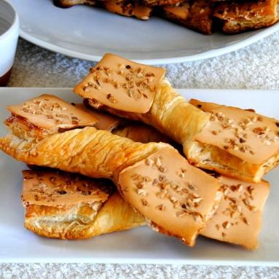
corbatas
teenshop13@hotmail.com
- Try our fantastic corbatas! Puff pastry with a delicious cover of sugar and almods. Ingredients:
Puff pastry
Wheat flour
Butter
Margarine
Sugar
Egg vlara
Almonds
Salt
- Price: 4,29 €
- Reference: 031

Slide 20
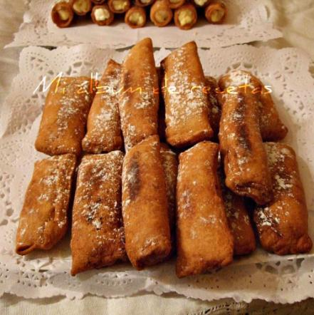
casadiellas
teenshop13@hotmail.com
- 6 units. Ingredients:
Egg yolk
Margarine
Salt
Yeast
Sunflower oil
Icing sugar
Chopped nuts
Crushed sugar
- Price 4.30 €
- Ref: 032

Slide 21
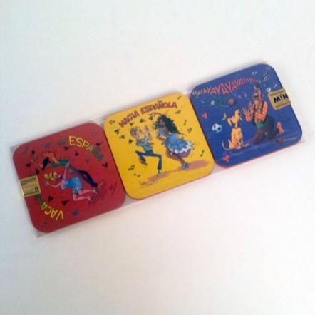
Coaster of spain
teenshop13@hotmail.com
- Set of six coasters with funny Spanish scenes: flamenco, bullfighting and guitars. Made of wood and plasticized, they have a square shape with rounded corners. Their size is 9.5 x 9.5 cm.
- Price: 2.50 €
- Ref: 033

Slide 22
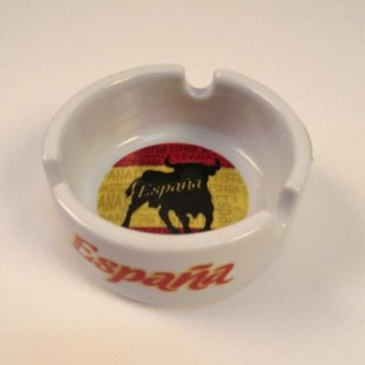
Spanish ashtray
teenshop13@hotmail.com
- Ashtray with the flag of Spain and a bull. Its diameter is 6 cm.
- Price: 3.50 €
- Ref: 034

Slide 23
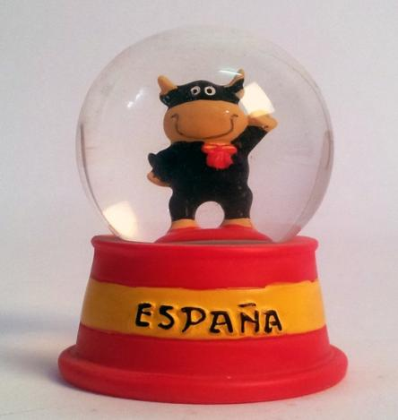
Spanish crystal ball
teenshop13@hotmail.com
- Crystal ball of Spain with a small bull inside. Great souvenir of Spain for both adults and children. Its size is 5 cm of diameter and 6.5 cm high.
- Price: 3.50 €
- Ref: 035

Slide 24
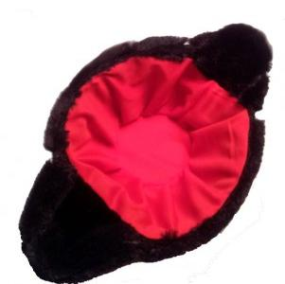
montera
teenshop13@hotmail.com
- Montera bullfighter costume. Made up of black synthetic hair with red lining. Available in two sizes: large (18 cm diameter) and small (14 cm diameter).
- Price: 5 €
- Ref: 036

Slide 25
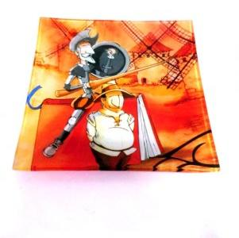
Spanish plate
teenshop13@hotmail.com
- Square glass plate with a picture of Don Quijote and Sancho Panza. It is 14.5 x 14.5 cm.
- Price: 4 €
- Ref: 037

Slide 26
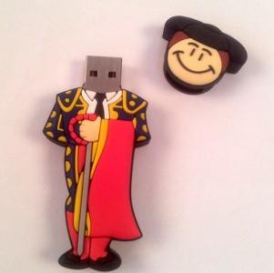
PENDRIVE
teenshop13@hotmail.com
- Key USB storage (pictures, documents, music, etc) shaped bullfighter. It measures 7.5 cm and have a capacity of 8 GB Original Chip Toshiba, soft PVC material.
- Price 16 €
- Ref: 038

Slide 27
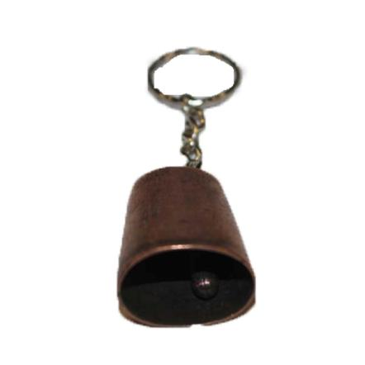
cowbell KEYCHAIN
teenshop13@hotmail.com
- A keychain with a mini cowbell where you can put your keys.
-Price: 2, 95 €
-Reference: 039

Slide 28
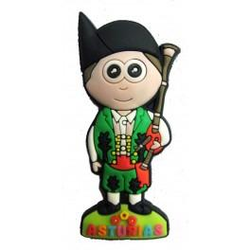
MAGNET FOR THE FRIDGE
teenshop13@hotmail.com
- Magnet which represents a man with a typical “Asturian” costume with the bagpipe and with a hat called “Montera Picona”. You can put this magnet on your fridge or in other magnetic surface. Its size is 7cm x 3cm.
- Price: 2,95 €
- Reference: 040

Slide 29
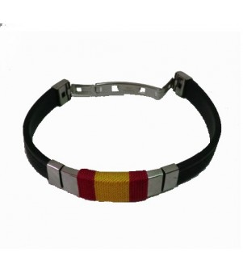
BRACELET
teenshop13@hotmail.com
- Unisex rubber bracelet with the Spanish flag and metal closure. It has no size because it is adjustable to any extent, the long and simply cutting back to fit in the clip will suit your needs.
- Price: 3, 50 €
- Reference: 01

