Slide 1
FORTUNATI
CATALOGUE

Slide 2
FOOD

Slide 3
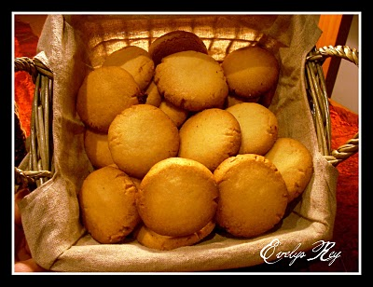
SUSPIROS DEL NALÓN
DESCRIPTION
Cookies typical Asturian made ​​primarily of flour, butter, and sugar.
WEIGHT: 600 grs (1 Dozen)
PRICE: 7,50€
REFERENCE: 01

Slide 4
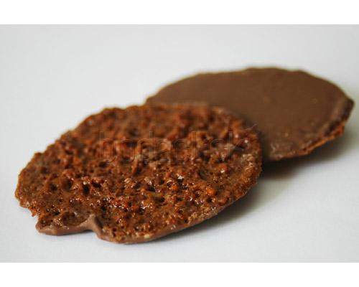
MOSCOVITAS
DESCRIPTION
Make their specialties with the best raw materials, such as almonds and chocolate
WEIGHT: 150grs (15 units)
PRICE: 7,30€
REFERENCE: 02

Slide 5
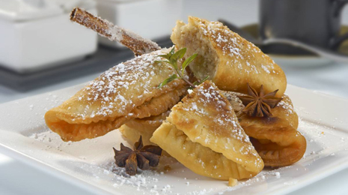
CASADIELLAS
DESCRIPTION
Made with butter, sugar, flour, and then passed in a pan, excellent dessert typical of Asturias.
AMOUNT
Half dozen / One dozen
PRICE: 6€ / 8,70€
REFERENCE: 03

Slide 6
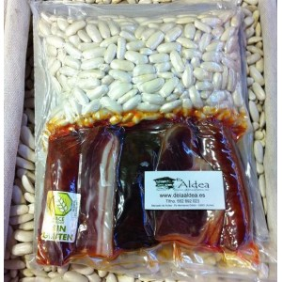
PORK AND COMPANGO
DESCRIPTION
Typical Asturian food, main course.
Is eaten with sausage.
WEIGHT: 500grs
PRICE: 17,50€
REFERENCE: 04

Slide 7
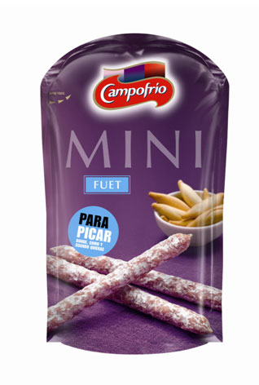
FUET
DESCRIPTION
Fuet delicious sticks to take with you anywhere.
WEIGHT: 50grs
PRICE: 1,50 €
REFERENCE: 05

Slide 8
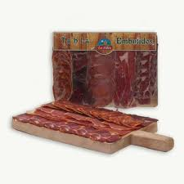
TABLE OF SAUSAGES
DESCRIPTION
Variety of sausages typical Asturian.
¡ALL KINDS!
AMOUNT: 250 grs
PRICE: 10€
REFERENCE: 06

Slide 9
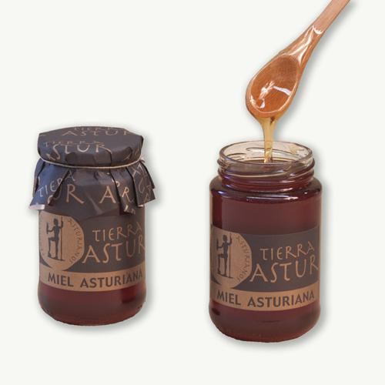
HONEY
DESCRIPTION
Honey collected from bees.
A treat for the palate and healthy.
WEIGHT: 1/2kg
PRICE: 6€
REFERENCE: 07

Slide 10
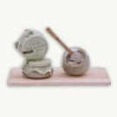
Cabrales cheese cream
DESCRIPTION: Typical asturian cheese.
WEIGHT: 180grs
PRICE: 4,60€
REFERENCE: 08

Slide 11
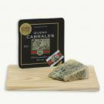
Cabrales cheese d.o. "Tasting gourmet"
DESCRIPTION: Typical asturian cheese.
WEIGHT: 100grs
PRICE: 3,90€
REFERENCE: 09

Slide 12
complements

Slide 13
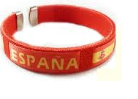
Spain bracelet
DESCRIPTION:
Is a bracelet with the Spanish flag.
You can buy it in different colors.
PRIZE: 2,50€
REFERENCE: 10

Slide 14
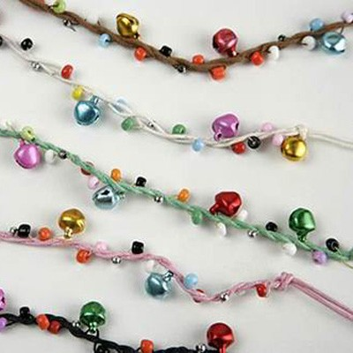
Bells brazalet
DESCRIPTION: It can be of diferent colours.
Beautiful bracelet of bells.
PRICE: 2,50€
REFERENCE: 11

Slide 15
Cow’s teddy
DESCRITION:
A cow’s teddy with the name of “Asturias”.
PRICE: 6€
REFERENCE: 12

Slide 16
Asturias keychain
DESCRITION:
Give your keys some color with this
keychain about 3 cm in height,
which will be the perfect addition
to your keys.
PRICE: 3€
REFERENCE: 13

Slide 17
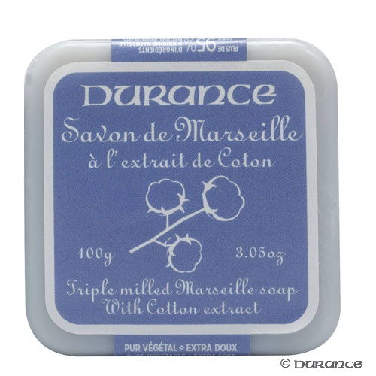
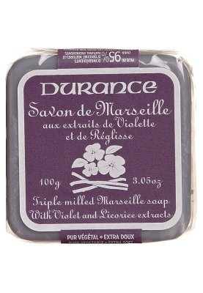
Soap
DESCRITION:
Marseille soap withcotton flower
extract.
PRICE: 3,95€
REFERENCE: 14

Slide 18
Class members
Laura Álvarez de la Arena
Ramón Tuya Otero
Pedro Pablo Polo Durán
Pablo López Fernández
Nuria Martínez Menéndez
Covadonga González Aguirre
Claudia Sánchez Pardo
Emilio González Gallego
Enrique Álvarez Solís
Ana Solares Canal
Elisa López Gómez
Laura Fidalgo Menéndez
Alba Fidalgo Menéndez
Jaime Miyares Ajuria
Guillermo Losada Fernández
Daniel Robles Díaz
Micaela Cañedo Azcona
Lucía García Valdés
Alejandro Allende Casal
Santiago Vigil Fernández

