Slide 1
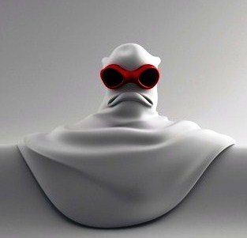
ELEVEN
GHOSTS

